Slide 1
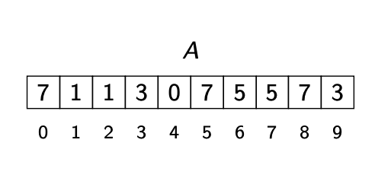
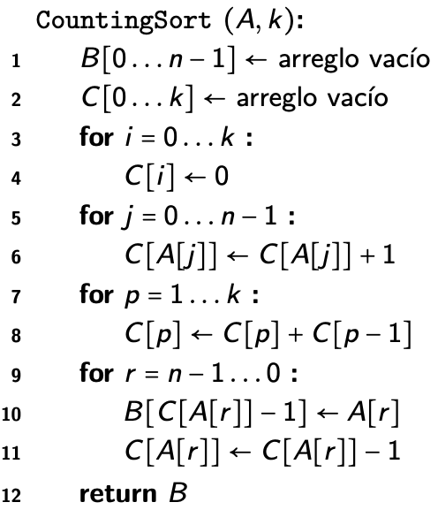
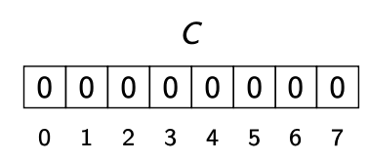
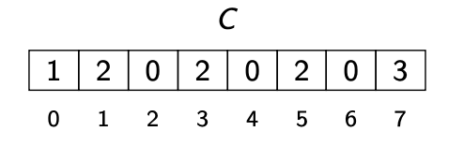
1
r | A[r] | C[A[r]] | B[C[A[r]]-1] <-A[r] | C[A[r]]-1
9 | 3 | 5 | B[4] <- 3 | 4
8 | 7 | 10 | B[9] <- 7 | 9
7 | 5 | 7 | B[6] <- 5 | 6
6 | 5 | 6 | B[5] <- 5 | 5
5 | 7 | 9 | B[8] <- 7 | 8
4 | 0 | 1 | B[0] < - 0 | 0
3 | 3 | 4 | B[3] <- 3 | 3
2 | 1 | 3 | B[2] <- 1 | 2
1 | 1 | 2 | B[1] <- 1 | 1
0 | 7 | 8 | B[7] <- 7 | 7
r | A[r] | C[A[r]] | B[C[A[r]]-1] <-A[r] | C[A[r]]-1
9 | 3 | 5 | B[4] <- 3 | 4
8 | 7 | 10 | B[9] <- 7 | 9
7 | 5 | 7 | B[6] <- 5 | 6
6 | 5 | 6 | B[5] <- 5 | 5
5 | 7 | 9 | B[8] <- 7 | 8
4 | 0 | 1 | B[0] < - 0 | 0
3 | 3 | 4 | B[3] <- 3 | 3
2 | 1 | 3 | B[2] <- 1 | 2
1 | 1 | 2 | B[1] <- 1 | 1
0 | 7 | 8 | B[7] <- 7 | 7
1
1
1
1
2
2
2
3
1
2
3
3
5
5
7
7
10

